Slide 1
Customer Churn Analysis
26.54%
churn rate
Telco customer data analysed with PostgreSQL, DBeaver, SQL, Power BI and Databricks
1,869 churned
5,174 stayed
of 7,043 customers
Khush Talera | Bigdata Analytics and DBMS
Notes:
Introduce the project: customer churn analysis of a telco dataset using PostgreSQL, DBeaver, SQL, Power BI and Databricks.

Slide 2




The data: 7,043 telco customers
What the data is and what each part means
7,043
21
Customer status
customers, one row each
columns describing each customer
Source
Telco customer churn dataset, supplied as telco.csv
26.54%
Churn column
Yes means the customer left, No means they stayed
churned
Four groups
Customer details, services, account and billing, and churn
Stayed
5,174 (73.46%)
Churned
1,869 (26.54%)
Loaded into
PostgreSQL and into Databricks
Notes:
The dataset has 7,043 customers and 21 columns. The Churn column records whether each customer left. 5,174 stayed and 1,869 churned, an overall churn rate of 26.54 percent. The same data was loaded into PostgreSQL and Databricks.

Slide 3






Purpose and workflow
Why the project was done and how the tools connect
Purpose: find the customer characteristics most linked to churn, and present them to support retention decisions.
CSV file
PostgreSQL
DBeaver
Power BI
Word and PowerPoint
Raw customer data
Stores the data (SQL Shell loads it)
Runs five analysis queries
Interactive charts and measures
Report and presentation
Parallel cloud route: the same data was also loaded into Databricks, where the churn dashboard was built.
Notes:
The purpose is to find which customer characteristics are most linked to churn. The main route is CSV to PostgreSQL, DBeaver queries, and Power BI. Databricks ran in parallel as a cloud route, where the dashboard was built. Word and PowerPoint present the results.

Slide 4

Tools: database and loading
PostgreSQL, SQL Shell (psql), and DBeaver
PostgreSQL
SQL Shell (psql)
DBeaver
WHERE WE USED IT
WHERE WE USED IT
WHERE WE USED IT
Stored the churn_db database and the telco table (7,043 rows)
Loaded the CSV with \copy, changed a column type, checked row counts
Created the database and table, ran the five analysis queries
WHY WE USED IT
WHY WE USED IT
WHY WE USED IT
Reliable database server that runs SQL and connects to Power BI
Loads files reliably and shows the exact line of any error
Visual SQL editor with a table browser and results grid
Notes:
PostgreSQL stores the data. SQL Shell loaded the CSV after the DBeaver import wizard failed. DBeaver created the database and table and ran the analysis queries.

Slide 5

Tools: dashboards and reporting
Databricks, Power BI, Microsoft Word, and Microsoft PowerPoint
Databricks
Where Loaded the data as a table and built the churn dashboard
Why Cloud platform for shared dashboards, no local server needed
Power BI Desktop
Where Connected to PostgreSQL; built the churn measure, card, and charts
Why Interactive dashboards with filters and calculated measures
Microsoft Word
Where Analysis report, project proposal, and work log
Why Standard academic format the professor can read and mark
Microsoft PowerPoint
Where This presentation, with editable charts and speaker notes
Why Clear format for presenting findings to the class
Notes:
Databricks hosted the cloud dashboard with KPI counters, a pie chart, bar charts, and a summary table. Power BI built the main interactive dashboard from PostgreSQL. Word holds the report and proposal, and PowerPoint is used for this presentation.

Slide 6



Data preparation: three issues fixed
Problems found while loading the data and how each was solved
11
~7,000
7,043
customers with a blank TotalCharges value
rows loaded before the import wizard stopped
rows loaded and verified
Blank values
Failed import
Verified load
Tool: SQL Shell
Tool: DBeaver, then SQL Shell
Tool: SQL Shell and DBeaver
11 customers had a blank TotalCharges value. It was stored as NULL after a temporary text conversion.
The import wizard stopped at about 7,000 rows. The file was reloaded with \copy, which loaded all rows.
7,043 rows loaded. The churn split of 5,174 No and 1,869 Yes matches the source file.
Notes:
Two issues came up during loading. Eleven customers had a blank total charges value, so those blanks were stored as NULL. The DBeaver import wizard failed, so the file was loaded with the SQL Shell \copy command instead.

Slide 7
SQL: five analysis queries
Run in DBeaver on the telco table in PostgreSQL (customer_churn_rate_by_khush.sql)
customer_churn_rate_by_khush.sql (queries 1 and 4, lines wrapped for the slide)
Five queries, one pattern
SELECT contract, COUNT(*) AS customers,
ROUND(100.0 * SUM(CASE WHEN churn = 'Yes'
THEN 1 ELSE 0 END) / COUNT(*), 1) AS churn_pct
FROM telco
GROUP BY contract
ORDER BY churn_pct DESC;
SELECT
CASE
WHEN tenure <= 12 THEN '0-12 months'
WHEN tenure <= 24 THEN '13-24 months'
WHEN tenure <= 48 THEN '25-48 months'
ELSE '49-72 months'
END AS tenure_group,
COUNT(*) AS customers,
ROUND(100.0 * SUM(CASE WHEN churn = 'Yes'
THEN 1 ELSE 0 END) / COUNT(*), 1) AS churn_pct
FROM telco
GROUP BY tenure_group
ORDER BY churn_pct DESC;
Each groups the telco table and returns customers and churn_pct, highest first.
1
Contract
Month-to-month 42.7%
2
Internet service
Fiber optic 41.9%
3
Payment method
Electronic check 45.3%
4
Tenure group (CASE)
0-12 months 47.4%
5
Tech support
No tech support 41.6%
Notes:
The SQL file holds the five analysis queries run in DBeaver. Every query groups the telco table by one column and returns the customer count and the churn percentage, sorted highest first. Shown here are the contract query, which is the template for the internet service, payment method and tech support queries, and the tenure query, which uses a CASE expression to build the four tenure groups. The highest-churn group in each query is listed on the right.

Slide 8
Python and PySpark: cleaning and cross-check
Notebook Bigdata_python_by_khush.ipynb repeats the contract analysis and matches the SQL
pandas: clean TotalCharges
PySpark: churn rate by contract
df = pd.read_csv("telco.csv")
# Clean TotalCharges
df["TotalCharges"] = pd.to_numeric(
df["TotalCharges"], errors="coerce"
)
df_clean = df.dropna(subset=["TotalCharges"]).copy()
contract_churn = (
spark_df
.groupBy("Contract")
.agg(
F.count("*").alias("Total_Customers"),
F.sum(
F.when(F.col("Churn") == "Yes", 1)
.otherwise(0)
).alias("Churned_Customers")
)
.withColumn(
"Churn_Rate_Percent",
F.round(
F.col("Churned_Customers") /
F.col("Total_Customers") * 100,
2
)
)
.orderBy(F.desc("Churn_Rate_Percent"))
)
11 blank TotalCharges rows are dropped for charge analysis only (7,043 to 7,032). Churn analysis keeps all 7,043.
Output: churn by contract
Contract | Customers | Churned | Churn %
Month-to-month | 3,875 | 1,655 | 42.71
One year | 1,473 | 166 | 11.27
Two year | 1,695 | 48 | 2.83
Notes:
The notebook cleans the data with pandas and then repeats the analysis in PySpark. In pandas, TotalCharges is converted to a number and the 11 blank rows are dropped for charge-based analysis only, leaving 7,032 rows. The PySpark query groups by contract and returns the same churn rates as the SQL work: 42.71 percent for month-to-month, 11.27 percent for one year and 2.83 percent for two year.

Slide 9
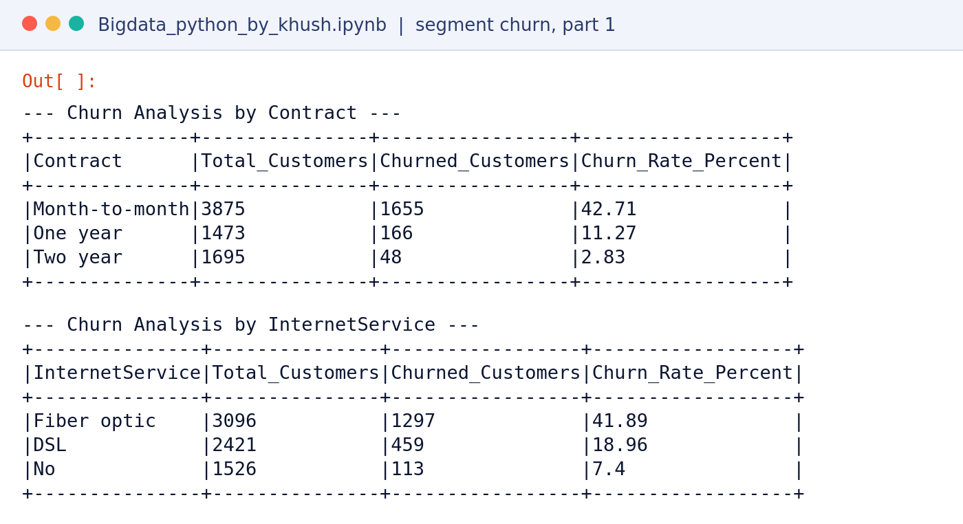
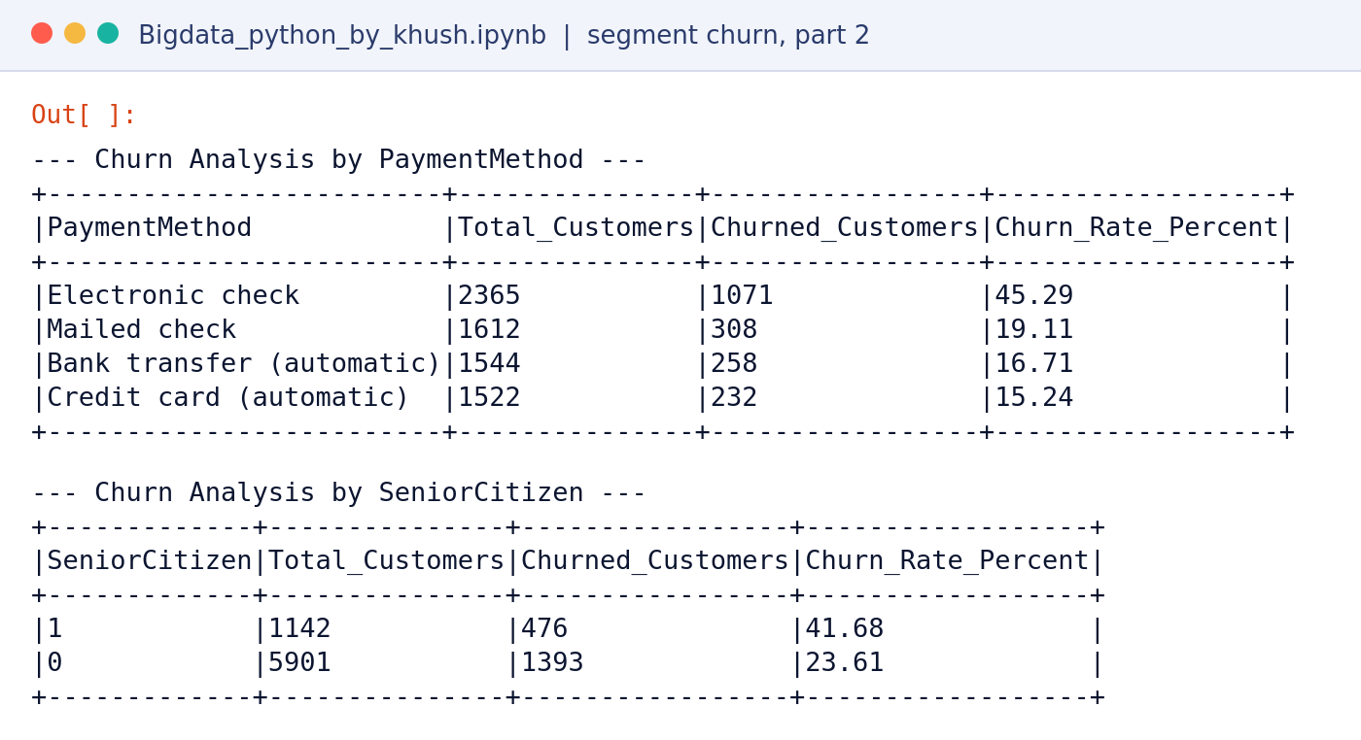

DBever output: churn by segment
Screenshots of the saved outputs in Bigdata_python_by_khush.ipynb
Matches the SQL
Contract 42.71%, fiber optic 41.89%, electronic check 45.29%
41.68%
of senior citizens churned, vs 23.61% of other customers (extra segment, notebook only)
Notes:
These are screenshots of the saved PySpark outputs in the notebook. The first three tables repeat the SQL results: contract, internet service and payment method. The notebook also checks the senior citizen segment, where 41.68 percent of senior citizens churned compared with 23.61 percent of other customers. This segment is not part of the SQL analysis.

Slide 10
Analysis 1: contract length
Purpose: test whether contract length is linked to churn
Churn rate by contract type
15×
Month-to-month customers churn about 15 times as often as two-year customers
Share of all customers
Month-to-month 55.02%
Two year 24.07%
One year 20.91%
Notes:
The X-axis shows the churn rate as a percentage. The Y-axis lists the contract types. Month-to-month customers churn at 42.7 percent, about 15 times the 2.8 percent for two-year customers. This is an association, but it suggests longer contracts help keep customers.

Slide 11
Analysis 2: internet service and payment
Purpose: compare churn across internet service types and payment methods
Churn rate by internet service
Churn rate by payment method
2×+
Fiber optic churn is more than double DSL
~3×
Electronic check churn is nearly three times credit card churn
Notes:
Both charts use the churn rate on the X-axis and the category on the Y-axis. Fiber optic customers churn at 41.9 percent, compared with 19.0 percent for DSL and 7.4 percent for no internet service. Electronic check payers churn at 45.3 percent, while automatic credit card payers churn at 15.2 percent.

Slide 12
Analysis 3: tenure and tech support
Purpose: test whether customer loyalty over time and add-on support are linked to churn
Churn rate by tenure group (months)
Churn rate by tech support
47.4% → 9.5%
Churn falls from 47.4% in year one to 9.5% after four years
2.7×
Without tech support, churn is about 2.7 times higher
Notes:
The line chart puts tenure groups on the X-axis and churn rate on the Y-axis. Churn falls from 47.4 percent in the first year to 9.5 percent after four years. The bar chart puts churn rate on the X-axis and tech support status on the Y-axis. Customers without tech support churn at 41.6 percent, compared with 15.2 percent for those with it.

Slide 13
Power BI dashboard: four report pages
From churn_analysis_by_khush.pbix, redrawn from the report's visual settings
PAGE 1 | CLUSTERED BAR
PAGE 2 | PIE
Churn rate by contract type
Customer churn split
PAGE 3 | DONUT
PAGE 4 | LINE
Share of customers by contract type
Churn rate by tenure group
Notes:
The Power BI report has four pages. Page 1 is a clustered bar chart of churn rate by contract type. Page 2 is a pie chart of the customer churn split, 5,174 No and 1,869 Yes. Page 3 is a donut chart of the share of customers by contract type. Page 4 is a line chart of churn rate by tenure group. These visuals are redrawn here from the report's visual settings and the same data.

Slide 14


Databricks dashboard: key numbers
Purpose: a cloud dashboard that shows headline figures and customer counts
7,043
26.54%
$64.76
32.4
Total customers
Churn rate
Avg monthly charges
Avg tenure (months)
Customers by contract type
Also included
Churn pie chart
Internet and payment bar charts
Summary table by contract
Notes:
The Databricks dashboard shows four KPI counters: 7,043 total customers, a 26.54 percent churn rate, an average monthly charge of 64.76 dollars, and an average tenure of 32.4 months. The bar chart shows customer counts by contract: 3,875 month-to-month, 1,695 two-year, and 1,473 one-year. Databricks bar charts show counts, while churn rates by group come from the SQL and Power BI work.

Slide 15

Findings, recommendations, and limitations
What the analysis shows, what to do about it, and what it cannot yet prove
KEY FINDINGS
RECOMMENDATIONS
OVERALL
CONTRACT
TENURE
Offer incentives for one- and two-year contracts
26.54%
42.7%
47.4%
1
overall churn
month-to-month vs 2.8% two-year
first-year customers churn
2
Focus on onboarding and early support in year one
3
Review fiber optic service quality and pricing
INTERNET
PAYMENT
SUPPORT
41.9%
45.3%
41.6%
4
Promote tech support to customers without it
fiber optic churns
electronic check users churn
no tech support vs 15.2% with it
Limitations: results show associations, not causes. Single-factor comparisons do not control for other variables. The data is one snapshot in time.
Notes:
Key findings: contract length, first-year tenure, fiber optic service, electronic check payments, and tech support are all linked to churn. The recommendations follow: encourage longer contracts, focus on the first year, review fiber optic service, and promote tech support. The main limitation is that these results show associations, not causes. Open the floor for questions.

